Slide 1
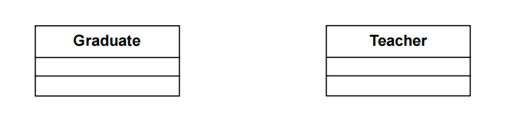
0..*
1

Slide 2
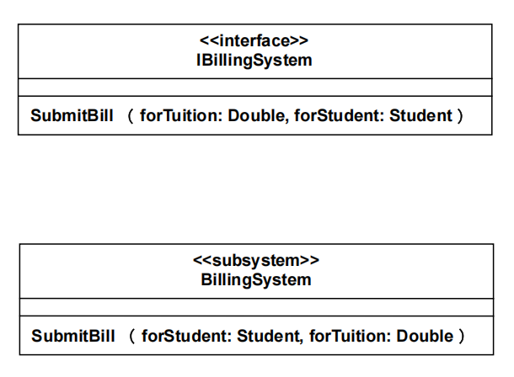

Slide 3
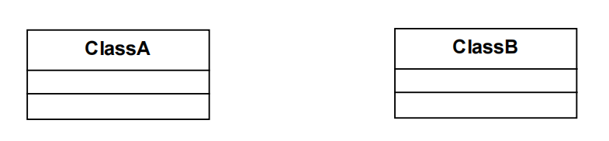

Slide 4
User
Order
LineItem
Item
paymentInfo
trackingNumber
orderStatus
estimatedDeliveryDate
id
name
1
0..*
1
1..*
quantity
0..*
1
id
name
price
1
0..*
1
0..1
ShippingInfo
Account
address
phoneNumber
recipient
1
0..*
1
BillingInfo
id
time
price
items
0..*

Slide 5
power on / startup action
Off
Self Test
[test fails]
Out of Service
[test passes]
Idle
do: waits for customer interaction
card inserted
Serving Customer
entry / readCard
cancel event

